Slide 1
Final Project: Sokoban Solving using Reinforcement Learning

Slide 2
TABLE OF CONTENTS
01
02
03
04
05
Introduction
Environment
Algorithms
Experiment
Conclusion

Slide 3
01
Introduction

Slide 4
The game of Sokoban, a classic puzzle game, presents a unique challenge in the realm of artificial intelligence and reinforcement learning. In Sokoban, the player is tasked with moving boxes to designated target locations within a constrained environment.
Reinforcement Learning, a subfield of machine learning, focuses on training agents to make sequences of decisions that maximize cumulative rewards. As an ideal candidate for Sokoban problem-solving, RL can enable agents to learn effective strategies for pushing boxes to their target positions while avoiding obstacles and dead-ends.
The primary goal of this paper is to evaluate the effectiveness of five distinct RL algorithms—Value Iteration, Policy Iteration, Monte Carlo, Q-learning, and SARSA—in solving the Sokoban puzzle within the Gym Sokoban environment not just the traditional map but also our customize map

Slide 5
02
Environment

Slide 6
Environment
Object
Reward
Each step | -0.1 | On target | +1
Off target | -1 | Finished | +10
13 Difference Actions
State(int) = index(All_state)

Slide 7
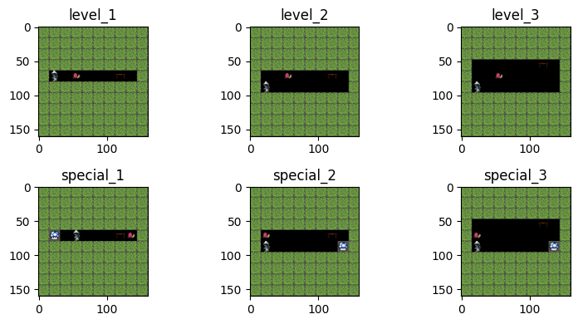

Slide 8
03
Algorithms

Slide 9
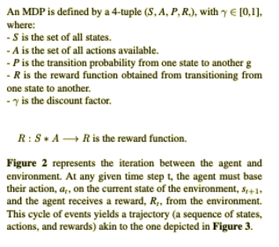
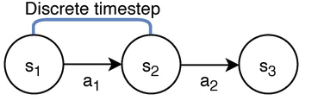
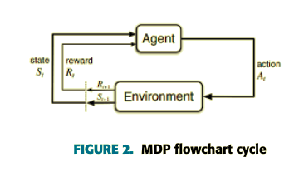
Markov’Decision Process
(MDP)

Slide 10
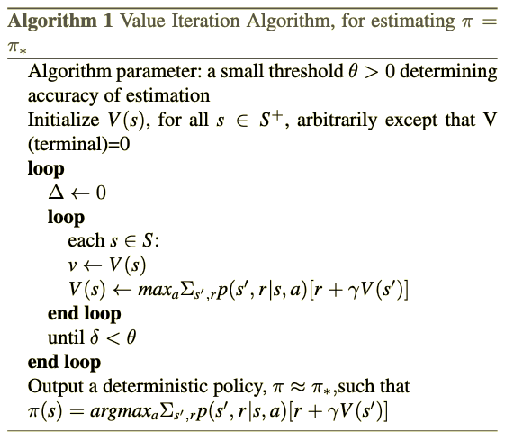
Value Iteration

Slide 11
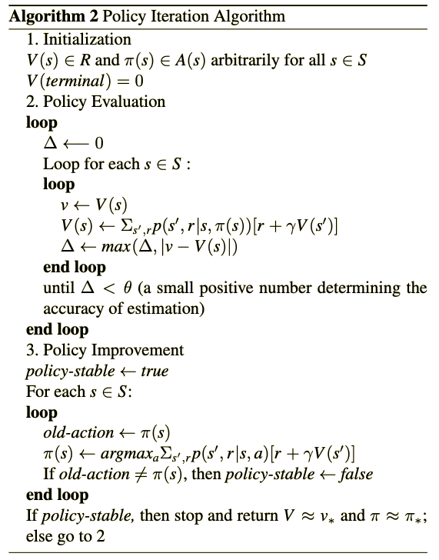
Policy Iteration

Slide 12
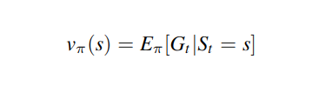
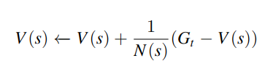
First Visit Monte Carlo
State-value function
Simplify function

Slide 13
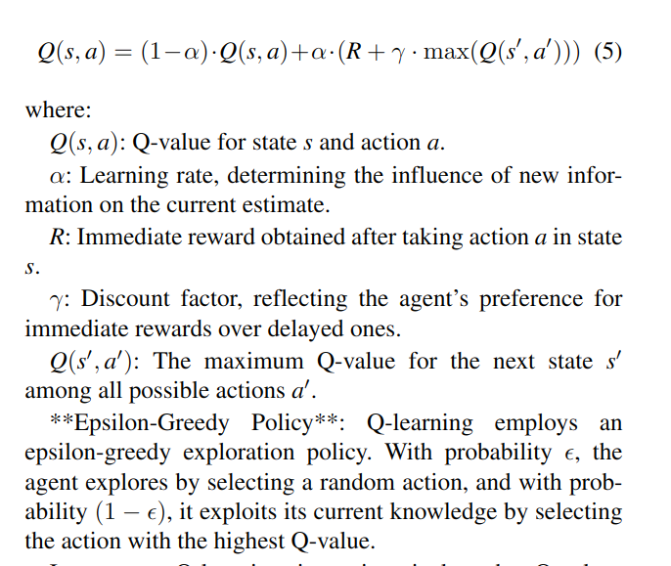
Q-learning

Slide 14
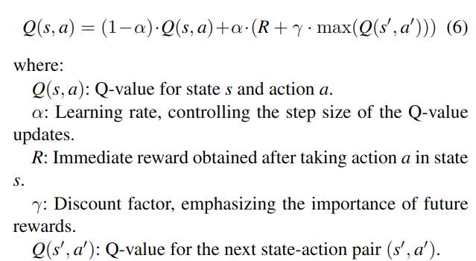
SARSA

Slide 15
04
Experiment Result

Slide 16
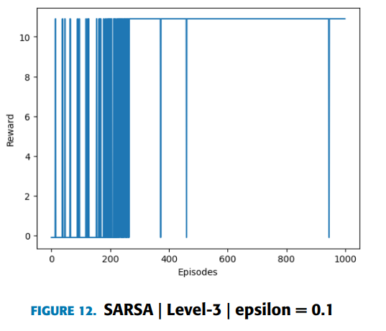
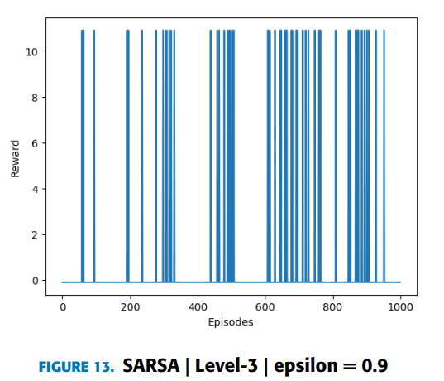

Slide 17
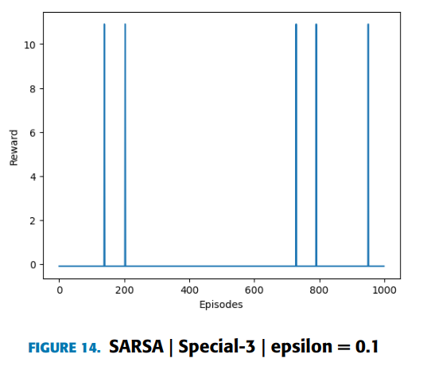
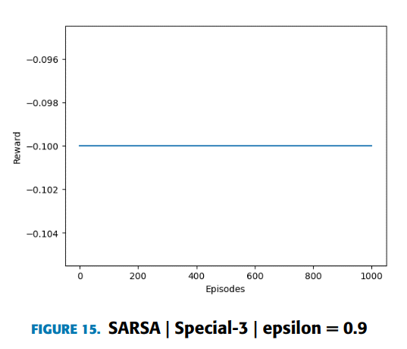

Slide 18
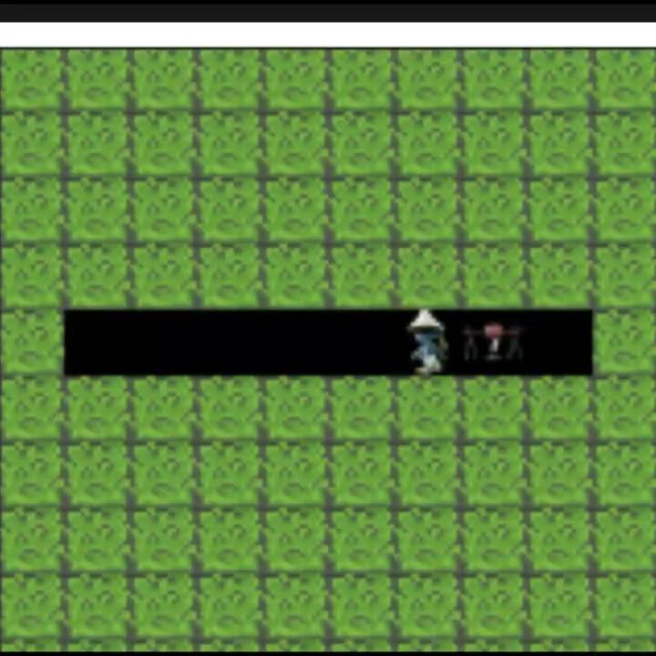

Slide 19
05
Conclusion

Slide 20
THANKS!
Please keep this slide for attribution

